Slide 1

Social Media Engagement & Performance Analysis
Complete data analytics lifecycle: from raw data to actionable insights

Slide 2


Project Scope
Objective
Dataset
Analyze social media performance across platforms to identify engagement drivers
1,500 posts across Facebook, Instagram, Twitter
Deliverable
Interactive dashboard with actionable business insights

Slide 3
Technology Stack
Python
MySQL
Data cleaning, feature engineering, EDA with Pandas & Matplotlib
Structured querying and business analysis
Excel
Power BI
KPI validation, pivot tables, sanity checks
Interactive visualization & storytelling

Slide 4


Data Cleaning & Feature Engineering
Data Cleaning
New Features Created
Removed duplicate records
Engagement Rate
Verified data types
Performance Label
Standardized formats
Viral Flag
Engagement Rate Formula: (Likes + Comments + Shares + Saves) / Likes

Slide 5



Performance Classification
High Performance
Average
Low Performance
Engagement ≥ 1.2× average
Within ±20% of average
Engagement ≤ 0.8× average
Viral Content
Shares in top 10 percentile + above-average engagement

Slide 6
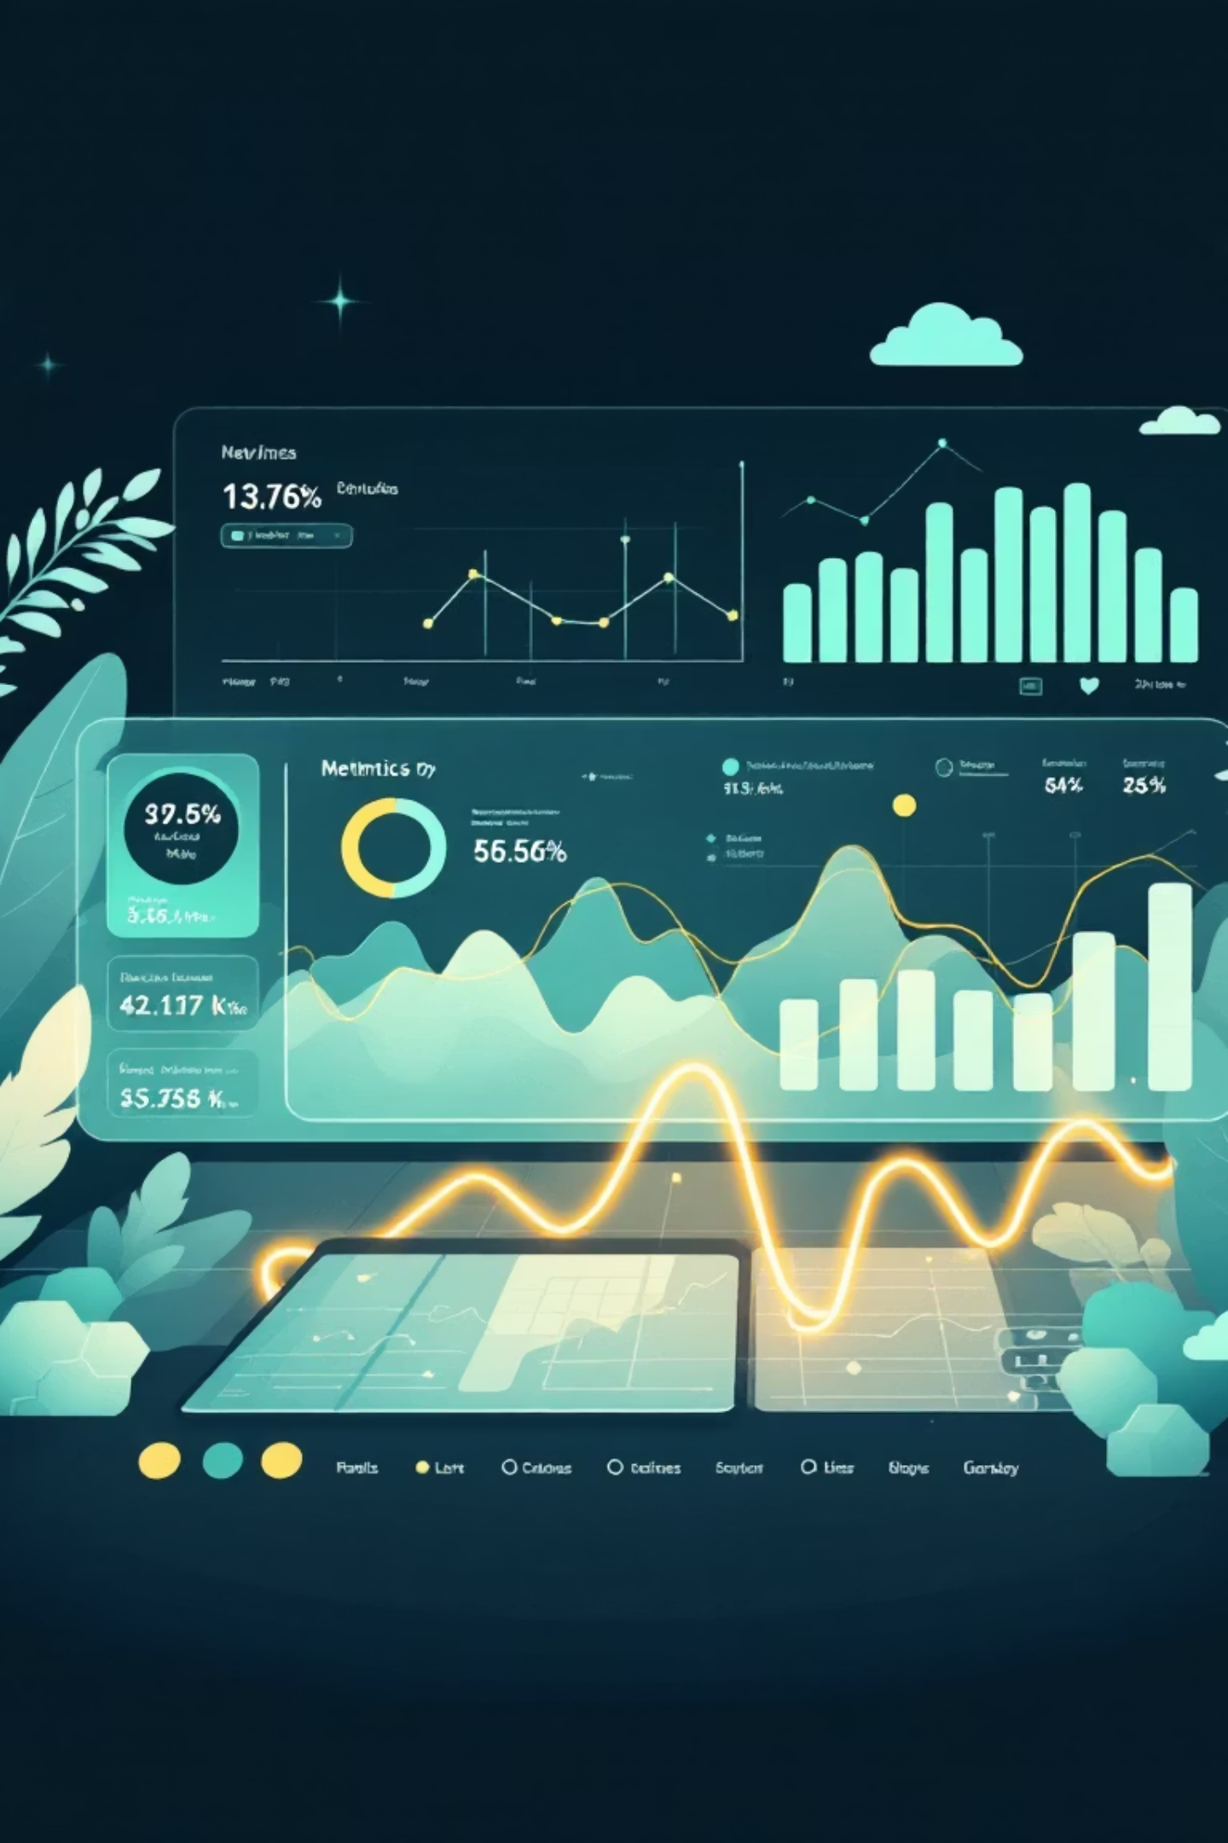
Key Performance Indicators
1,500
2.01
15.27%
Total Posts
Avg Engagement Rate
High Performers
Analyzed across all platforms
Posts exceeding benchmarks
Overall performance metric
2.53%
Viral Content
Top-tier engagement posts

Slide 7

Platform Performance Insights
Instagram Leads
Content Type Matters
Highest engagement rate among all platforms
Images & Reels outperform Carousel posts
Timing is Critical
Evening hours (8-11 PM) drive peak engagement

Slide 8
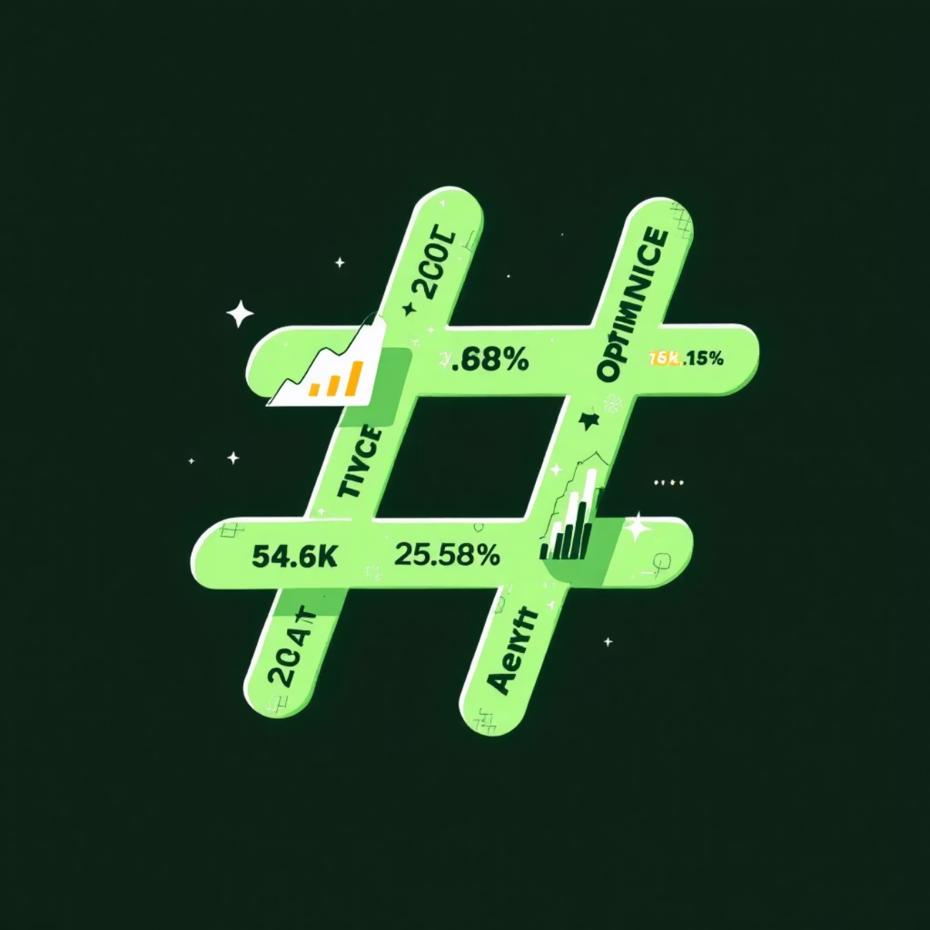
Hashtag Strategy Analysis
Key Finding
Excessive hashtags don't always increase engagement — optimal usage matters
Quality over quantity drives better results
"Only a small percentage of posts go viral, emphasizing the importance of content quality"

Slide 9

Interactive Dashboard Features
KPI Cards
Real-time metrics: engagement rate, viral %, total posts
Visual Analytics
Platform & post type performance comparisons
Time Analysis
Best posting hours by engagement trends
Dynamic Filters
Slicers for platform, post type, day of week

Slide 10

Business Impact & Skills
Actionable Outcomes
Skills Demonstrated
Optimize posting strategy
End-to-end analytics workflow
Improve content format selection
Feature engineering & EDA
Maximize engagement performance
SQL business analysis
Data-driven marketing decisions
Dashboard storytelling

